Slide 1
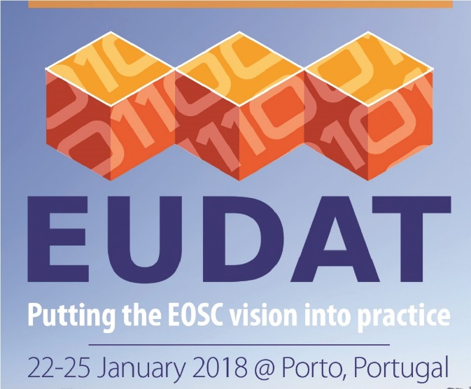
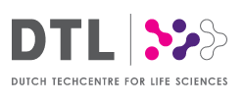

B2SHARE-FAIR
A proxy of B2SHARE as a FAIR Data Point
João Moreira¹, Luiz Bonino², Thijs Cobben³
¹ University of Twente - j.luizrebelomoreira@utwente.nl
² Dutch Techcentre for Life Sciences (DTL) - luiz.bonino@go-fair.org
³ SURFsara BV - thijs.cobben@surfsara.nl

Slide 2
Agenda
Introduction
Motivation
Background: B2SHARE and FAIR Data Point (FDP)
Design problem
Solution
Align B2SHARE with FDP
Proxy B2SHARE with “semantic translations”
Validation
Conclusions
Contributions and future work

Slide 3
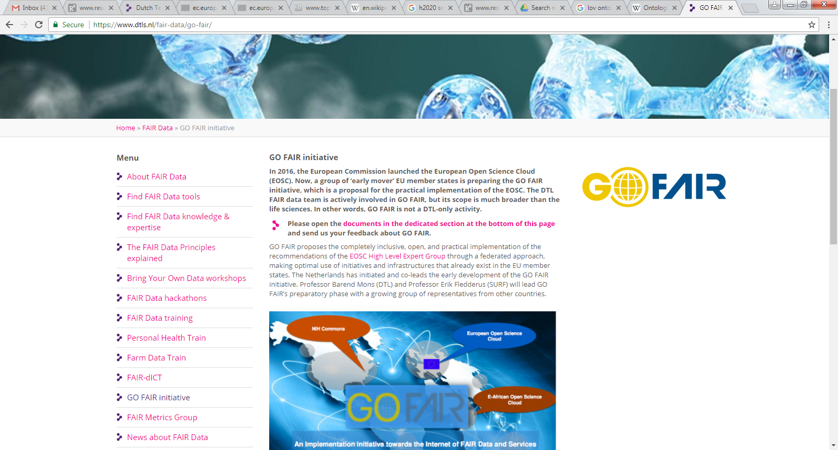

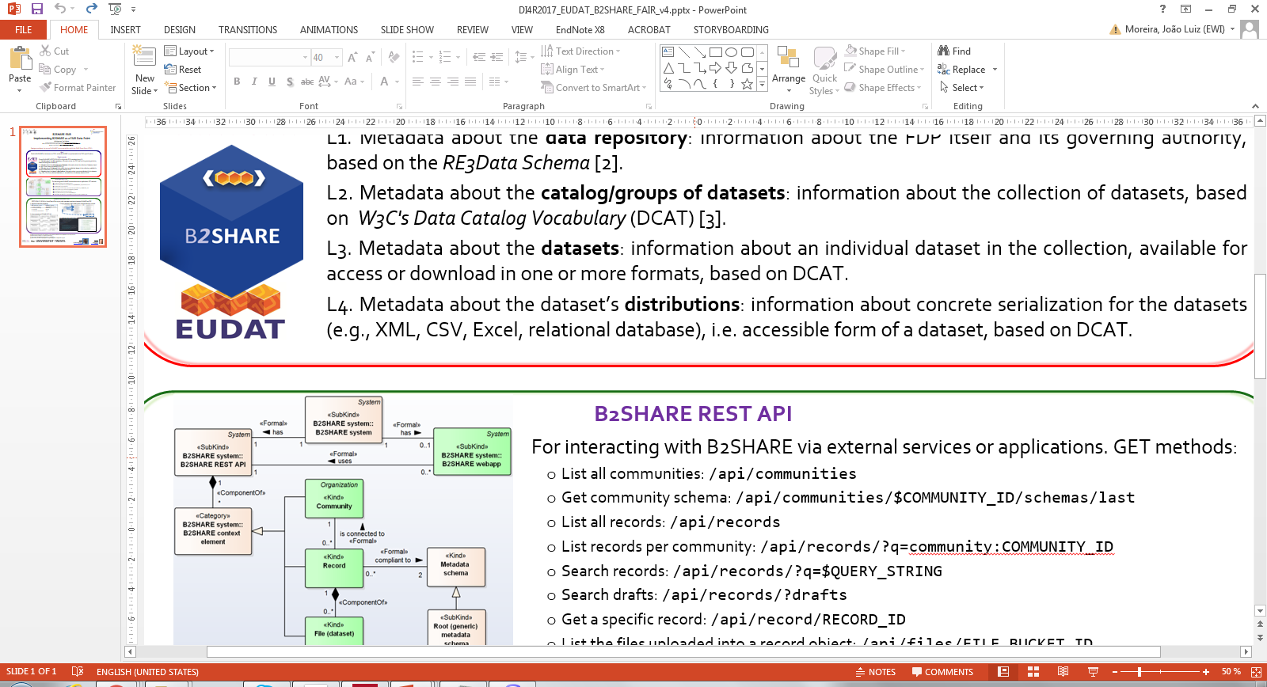
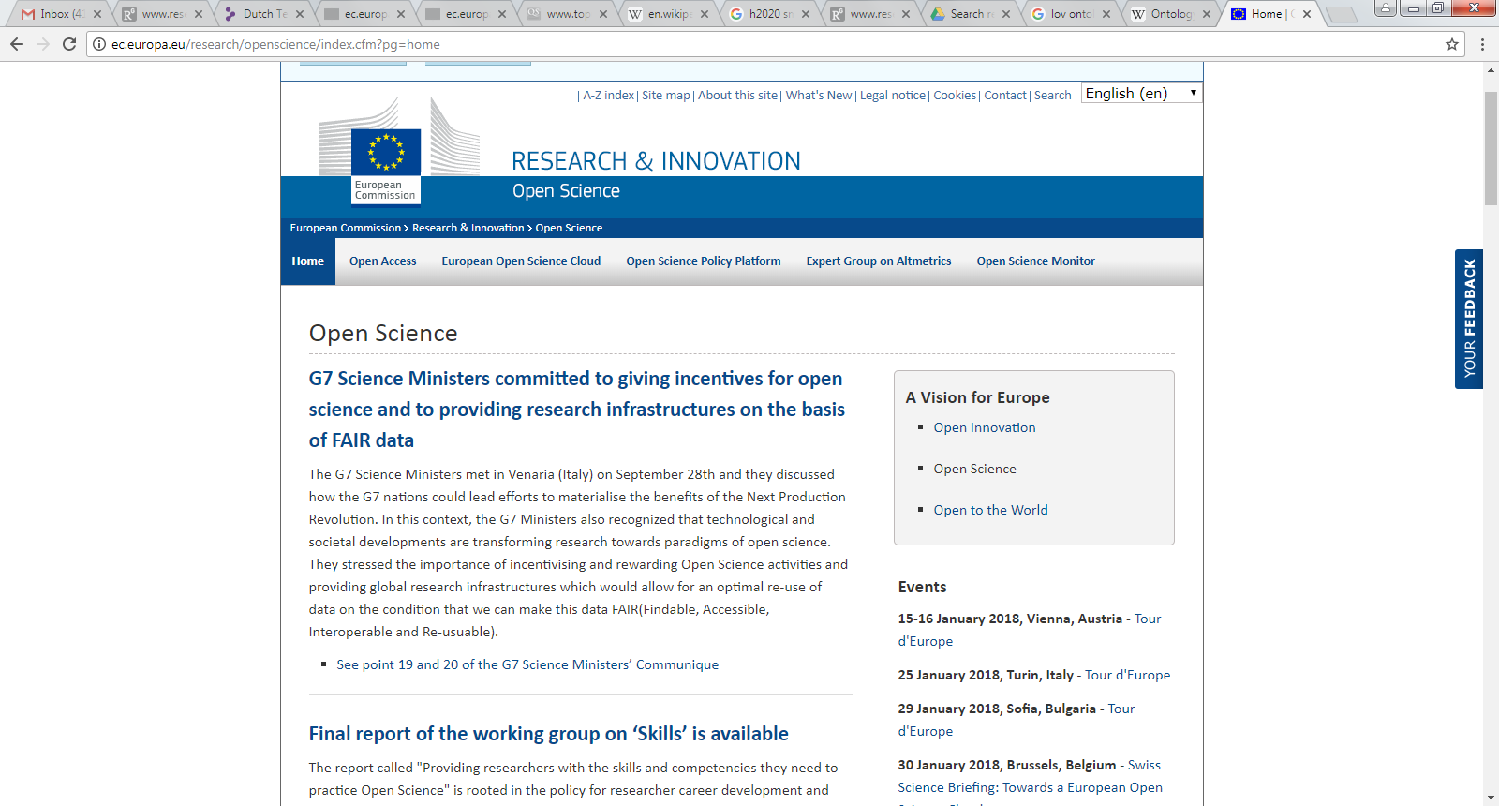
Motivation
store/publish research data
What is the “FAIRness” of B2SHARE as a data repository?

Slide 4
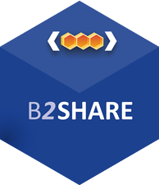
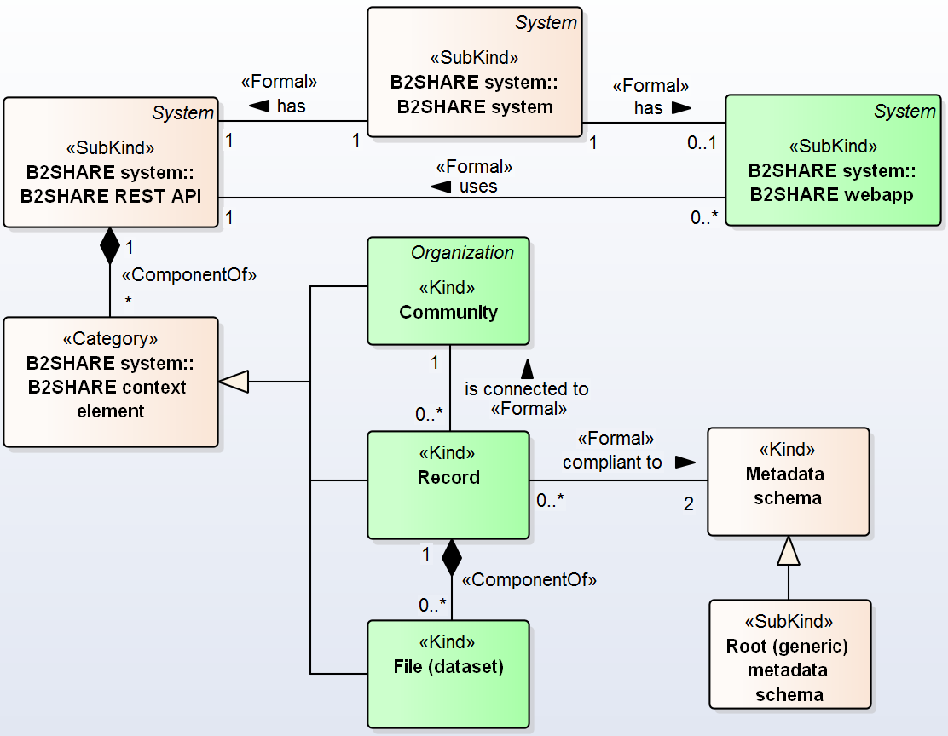
Background
B2SHARE system: web application + REST API
REST API methods:
. Get web application: /api/
. List all communities: /api/communities
. Get a community:
/api/communities/$ID
. List all records: /api/records
. List records per community:
/api/records/?q=community:ID
. Search records:
/api/records/?q=$QUERY_STRING
. Search drafts: /api/records/?drafts
. Get a specific record: /api/record/$ID
. List the files uploaded into a record object:
/api/files/FILE_BUCKET_ID

Slide 5

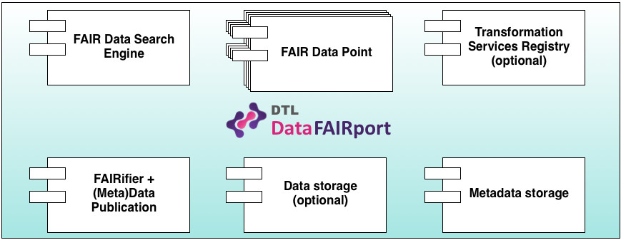
Background
FAIR Data Point (FDP)
Data storage and accessibility infrastructure to expose datasets, compliant to FAIR (REST API)
FDP metadata layers [1]: standardized approach
L1. Data repository: FDP and its governing authority (RE3Data [2])
L2. Catalog/group of datasets: collection of datasets (W3C DCAT [3])
L3. Dataset: individual dataset in the collection, in one or more formats (DCAT)
L4. Dataset distribution: serialization of dataset, e.g. XML, CSV, Excel, etc. (DCAT)
Semantic technologies
Resource Description Framework (RDF)
JSON for Linked Data (JSON-LD)
Turtle (TTL), XML, …
[1] FAIR Data Point Specification.
https://github.com/DTL-FAIRData/FAIRDataPoint/wiki/FAIR-Data-Point-Specification
[2] RE3Data Schema.
http://www.re3data.org/schema/3-0
[3] W3C's Data Catalog Vocabulary.
http://www.w3.org/ns/dcat

Slide 6
Problem
Design problem: how to improve the “FAIRness” of B2SHARE?
How to make B2SHARE compliant to FAIR data principles?
Goal: demonstrate how B2SHARE can behave as a FDP
POC showing how B2SHARE can be compliant with the FDP specification
Requirements
Develop “non-intrusive” solution (decoupled to B2SHARE)
Use B2SHARE REST API to access data
Improve semantic interoperability of B2SHARE
Enable B2SHARE REST API to provide semantic data (annotated)
Identify mappings between B2SHARE and FDP
Align B2SHARE terminology with FDP metadata layers

Slide 7
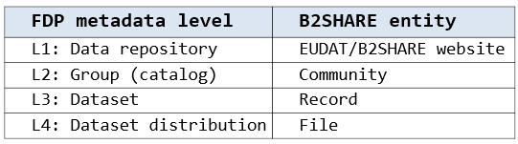
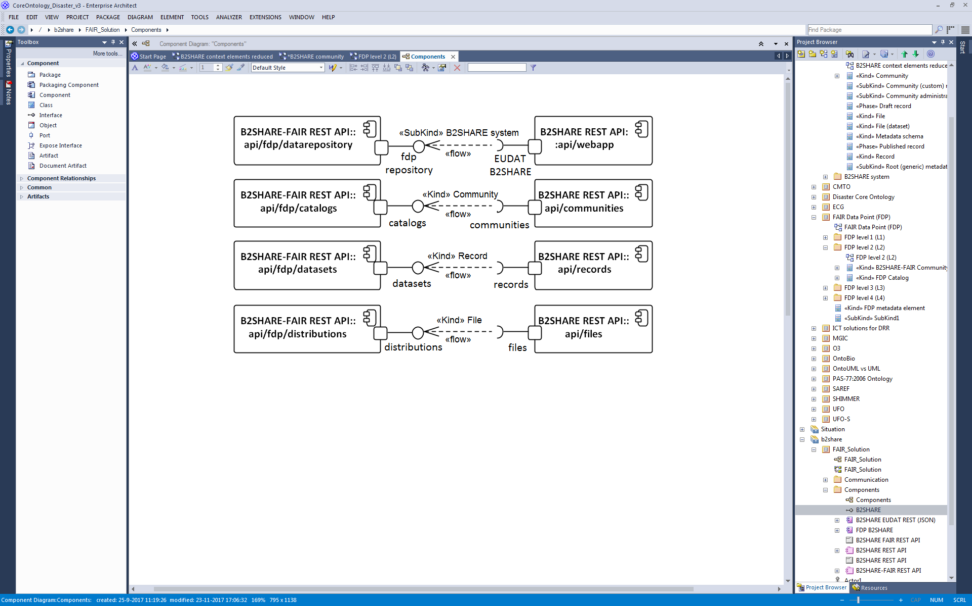
Solution
B2SHARE-FAIR: A proxy between B2SHARE and FDP as a REST/JSON-LD service
1- High-level metadata mappings
2- Proxy requests on B2SHARE REST API
https://github.com/jonimoreira/B2SHARE-FAIR

Slide 8
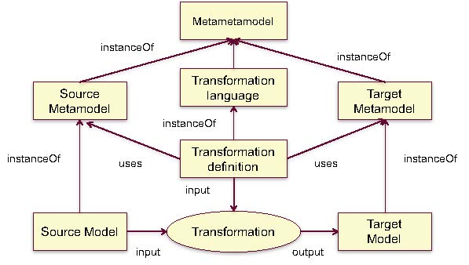
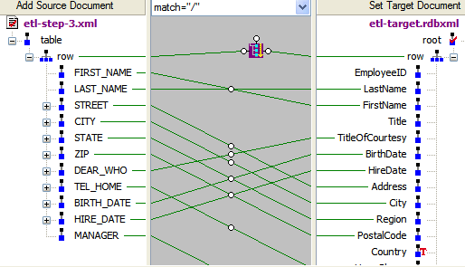
Solution
Model-driven transformations
Semantic translation: “process of changing the underlying semantics of a piece of knowledge. Given some information described semantically, in terms of a source ontology, it is transformed into information described in terms of a target ontology.”

Slide 9
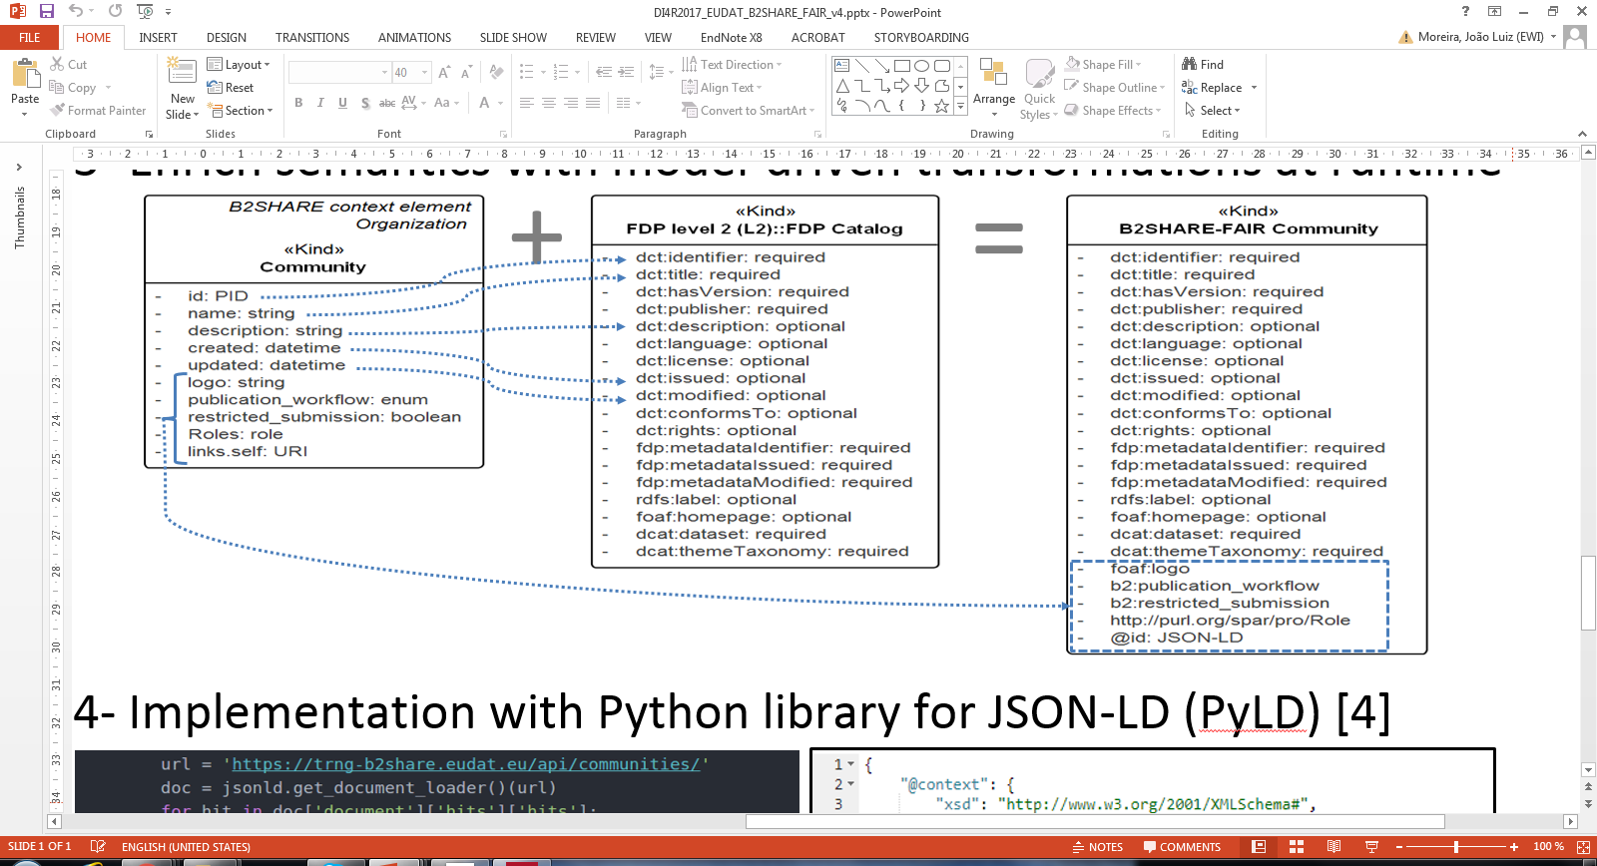
Solution
Example of mappings for Level 2: Community as Catalog/Group
Methodology to specify the translations

Slide 10
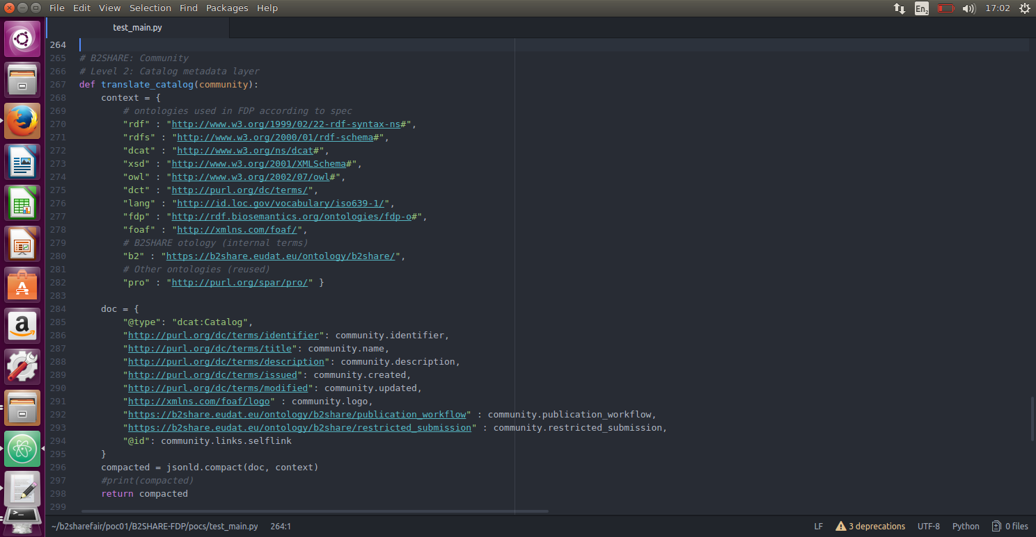
Solution
Implementation: Python library for JSON-LD (PyLD)

Slide 11
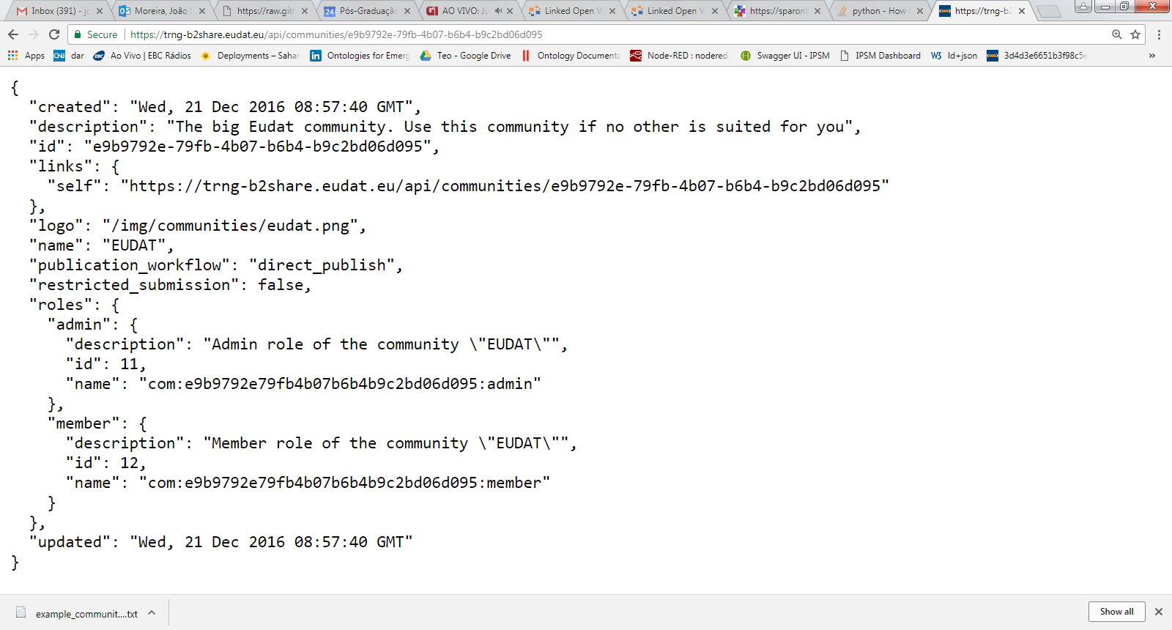
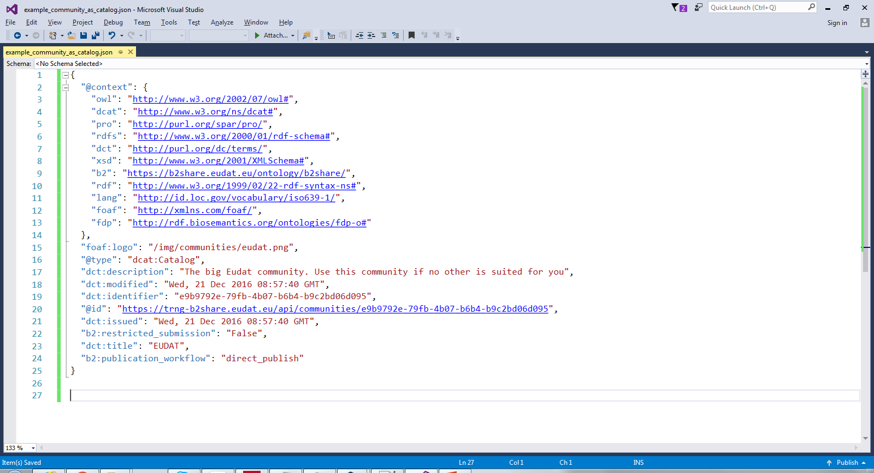
Solution
Initial validation: test data (https://trng-b2share.eudat.eu/api )
B2SHARE Community
FDP Catalog

Slide 12
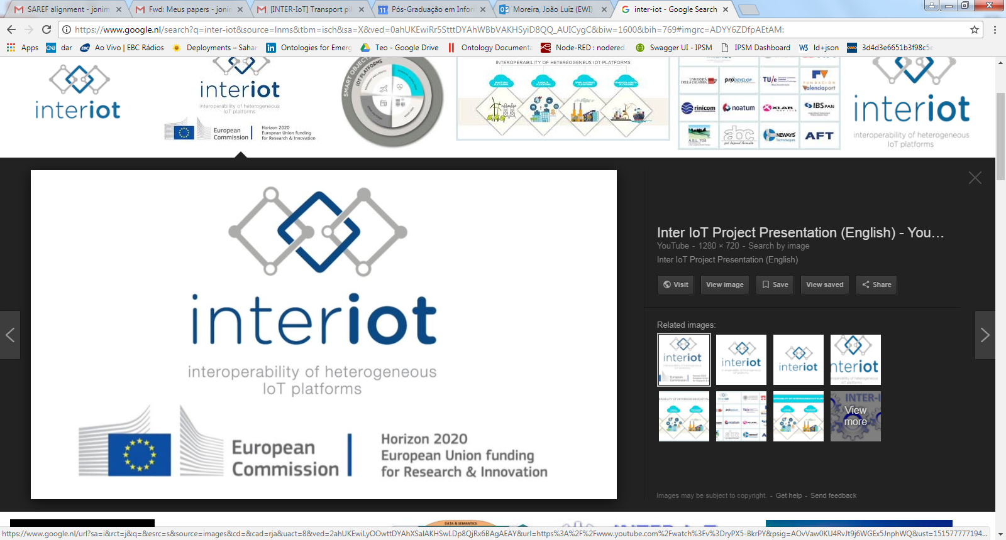
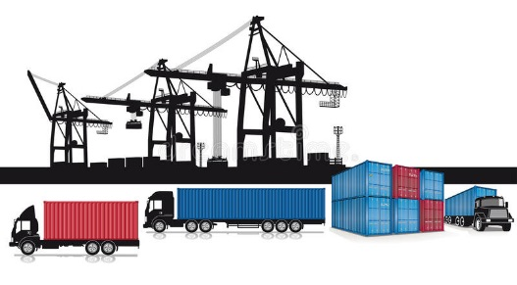





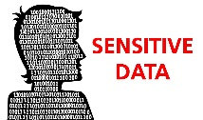
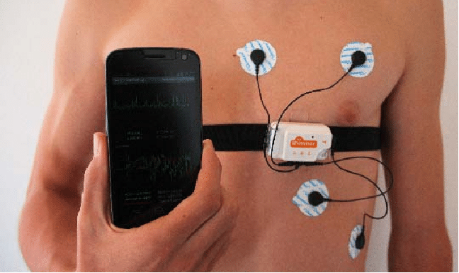
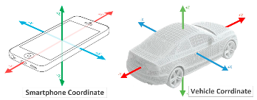
Validation plan
IoT early warning system (Valencia port): data generated and collected

Slide 13
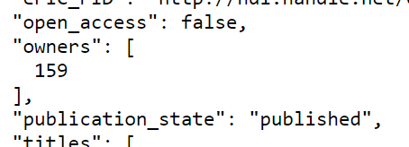
Conclusion
Contributions
First step for B2SHARE FAIRification
Proxy: feasible approach
Non-intrusive and less programming effort: “semantic translations”
Focused on reusing existing and standardized ontologies (W3C DCAT)
Poster presentation: DI4R 2017 conference
Future work
Levels of “A” in B2SHARE/B2ACCESS
Address “F” with B2FIND
Measure the “FAIRness”: apply FAIR metrics
Align with EUDAT semantic services’ efforts (Yann Le Franc)
5th level of FDP: domain (or cross-domain) ontologies
Ontological analysis and ontology-driven conceptual modeling

Slide 14

B2SHARE-FAIR
A proxy of B2SHARE as a FAIR Data Point
João Moreira¹, Luiz Bonino², Thijs Cobben³
¹ University of Twente - j.luizrebelomoreira@utwente.nl
² Dutch Techcentre for Life Sciences (DTL) - luiz.bonino@go-fair.org
³ SURFsara BV - thijs.cobben@surfsara.nl

